Slide 1
Will Cowan
Week 3 Storyboard

Slide 2
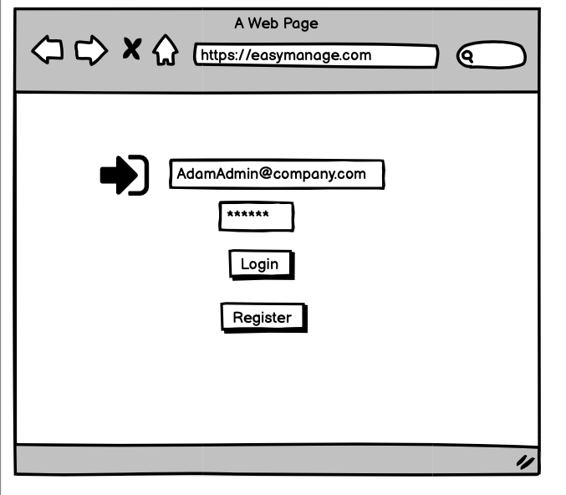
Creating an Award in Easy Manage
Adam Admin has to keep track of all his departments awards. It is his job to keep the department organized.
Adam will first log into EasyManage using his email address and password.

Slide 3
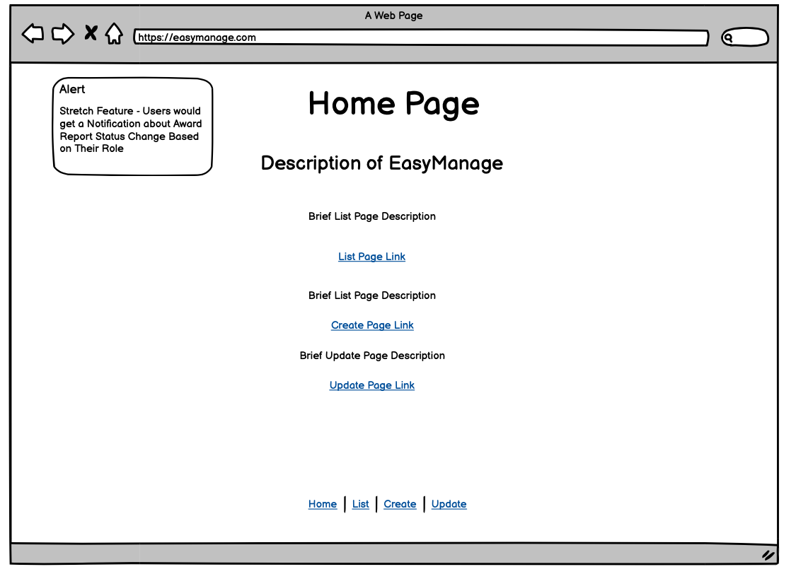
Creating an Award in Easy Manage
Adam will then come to the home page.
If Adam is unfamiliar with the application there will be a brief description he can read the description
He will navigate to the Create page using the link

Slide 4
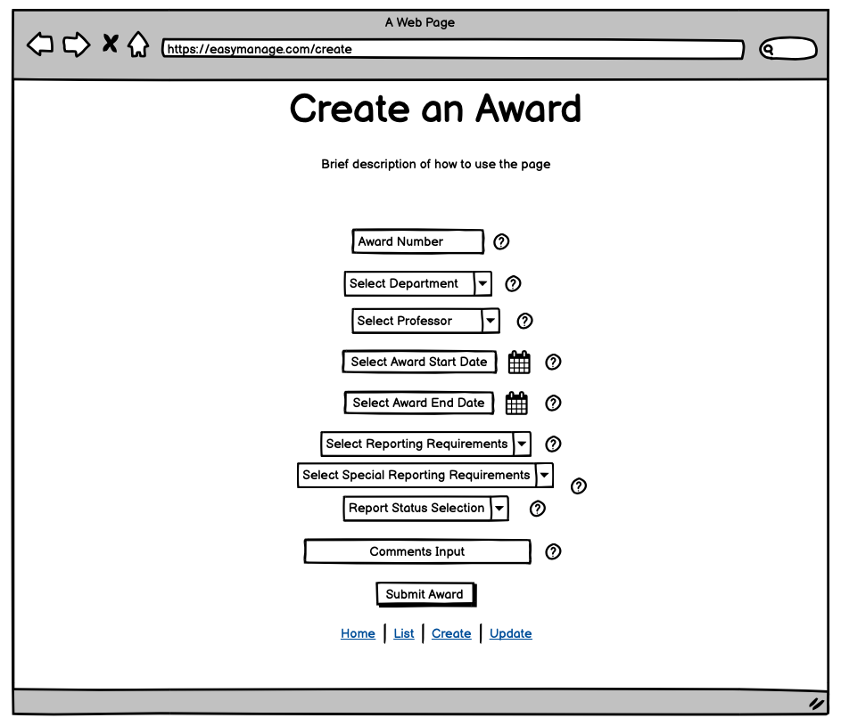
Creating an Award in Easy Manage
Adam will then come to the home page.
If Adam is unfamiliar with the application there will be a brief description he can read the description
He will navigate to the Create page using the link

Slide 5
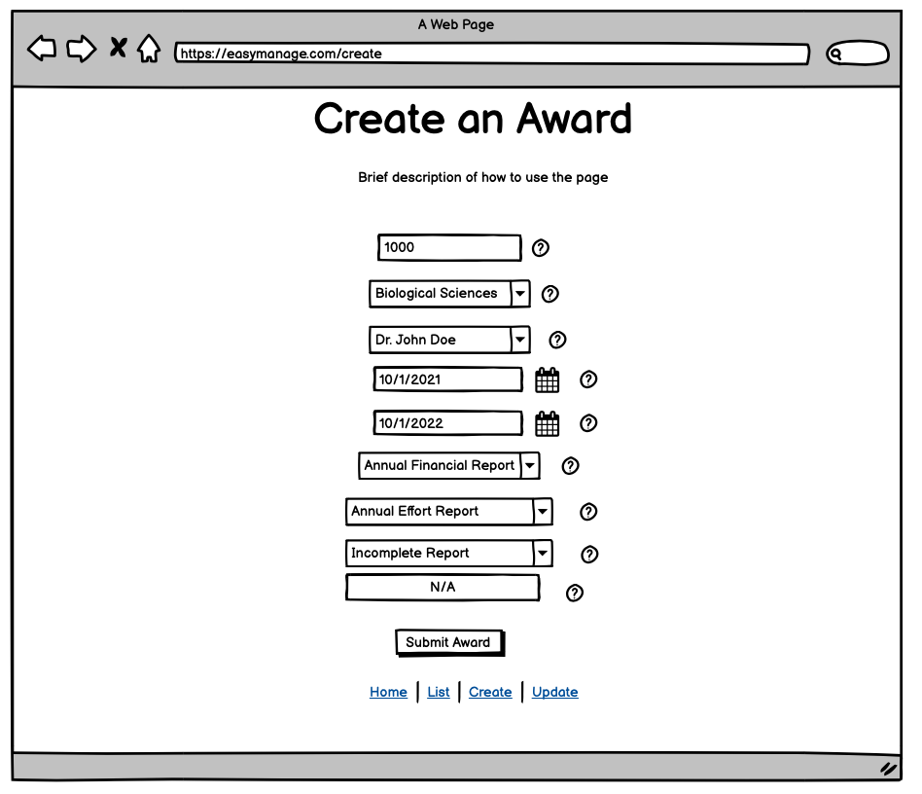
Creating an Award in Easy Manage
Adam will enter award information from the award contract or letter into EasyManage
If Adam is unsure about the field he can assess the information button
Adam will submit create the award

Slide 6
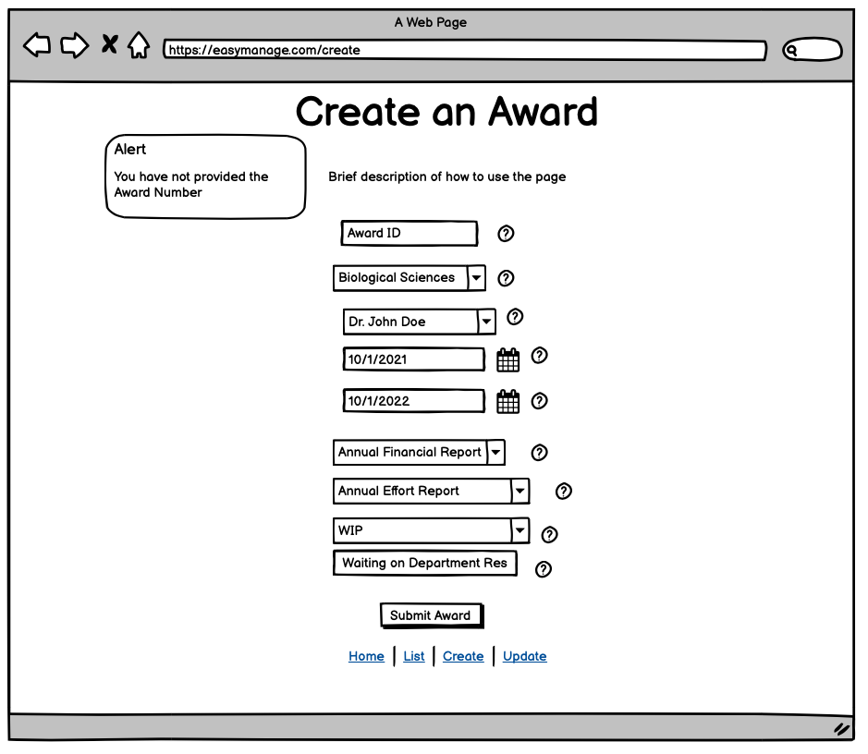
Creating an Award in Easy Manage
If Adam forgets to select award information he will get a notification letting him know he is missing information.

Slide 7
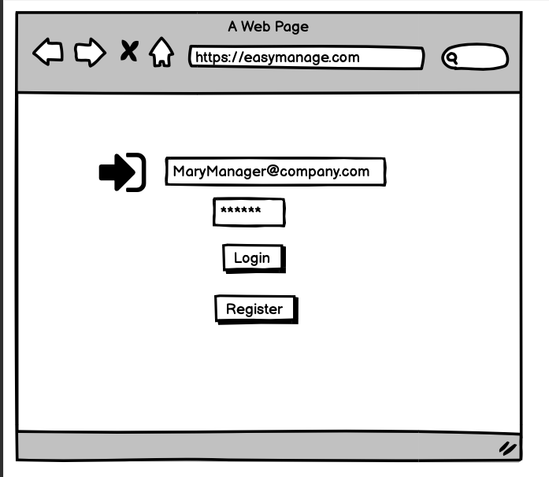
Finding Award Information in EasyManage
Mary Manager has to balance her team’s workload.
She needs to know what awards have reports due.
She can use EasyManage to pull reporting info and then assign an analyst to complete the report
She will log into EasyManage with her email and password

Slide 8
Finding Award Information in EasyManage
Once Mary has logged in she will come to the home screen.
If she has any questions about EasyManage she can read the descriptions.
She will navigate to the List page using the link to begin to search for awards

Slide 9
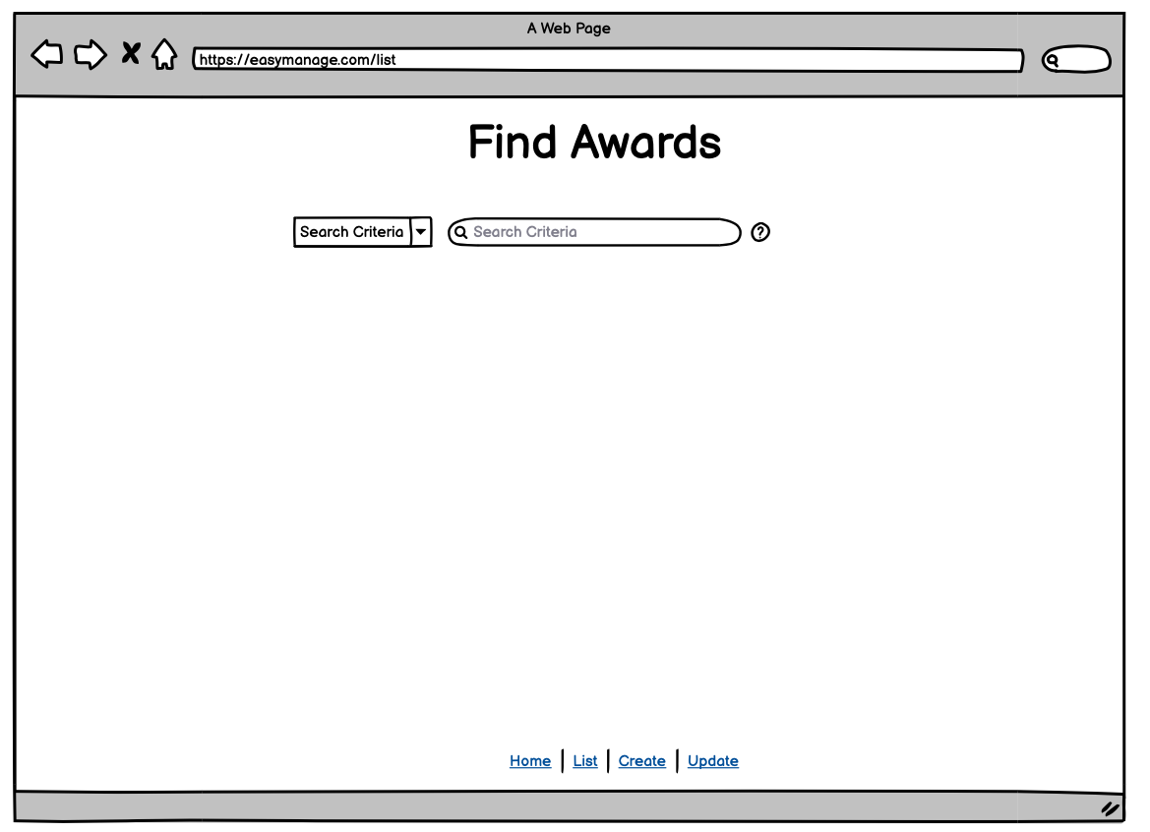
Finding Award Information in EasyManage
Mary Manager will then navigate to the List page to find awards

Slide 10
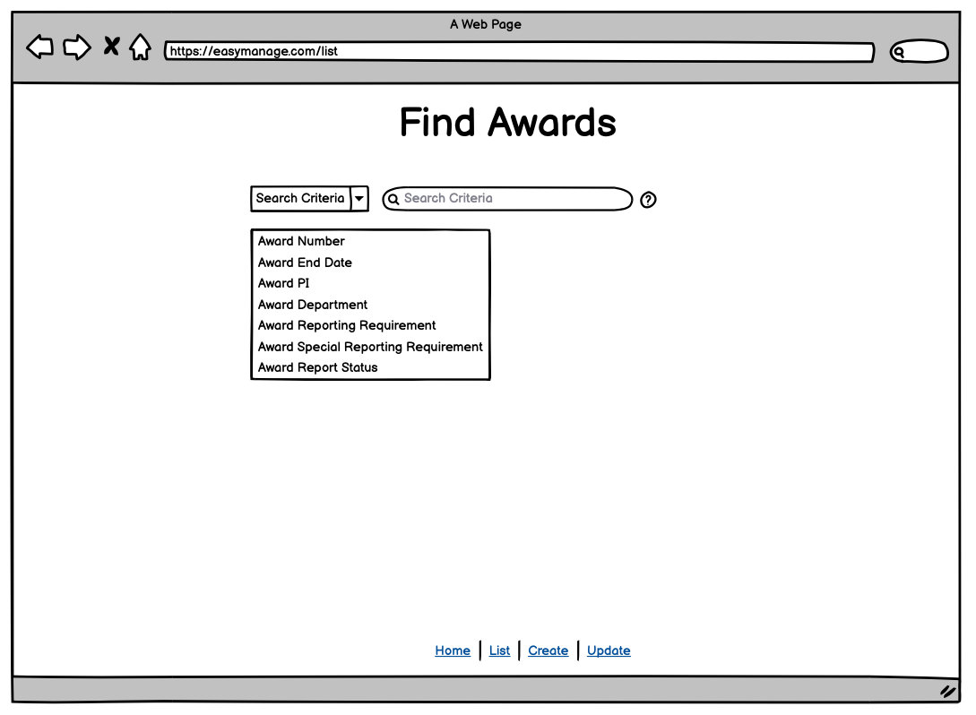
Finding Award Information in EasyManage
Mary Manager will then select the search criteria and search for awards

Slide 11
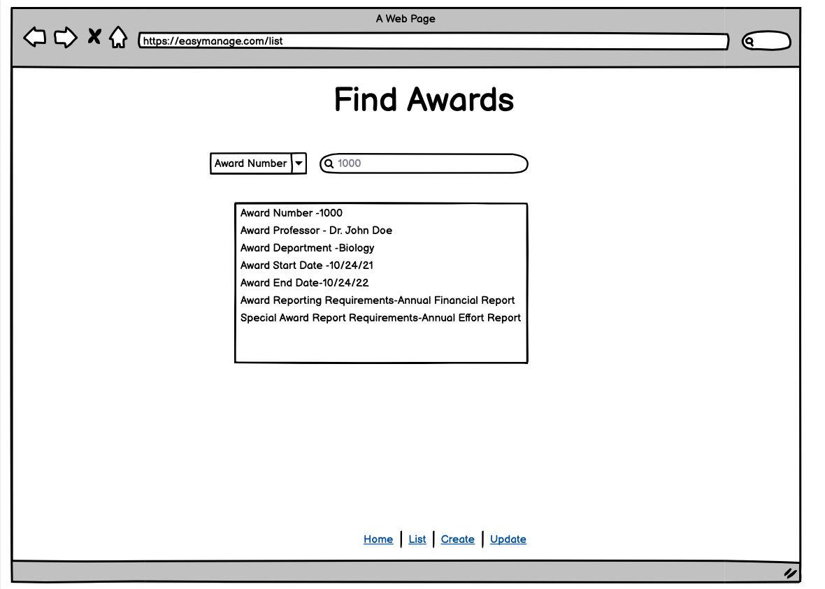
Finding Award Information in EasyManage
The award information will be returned to Mary.
Mary can then pass the information on to an analyst to complete the award.

Slide 12
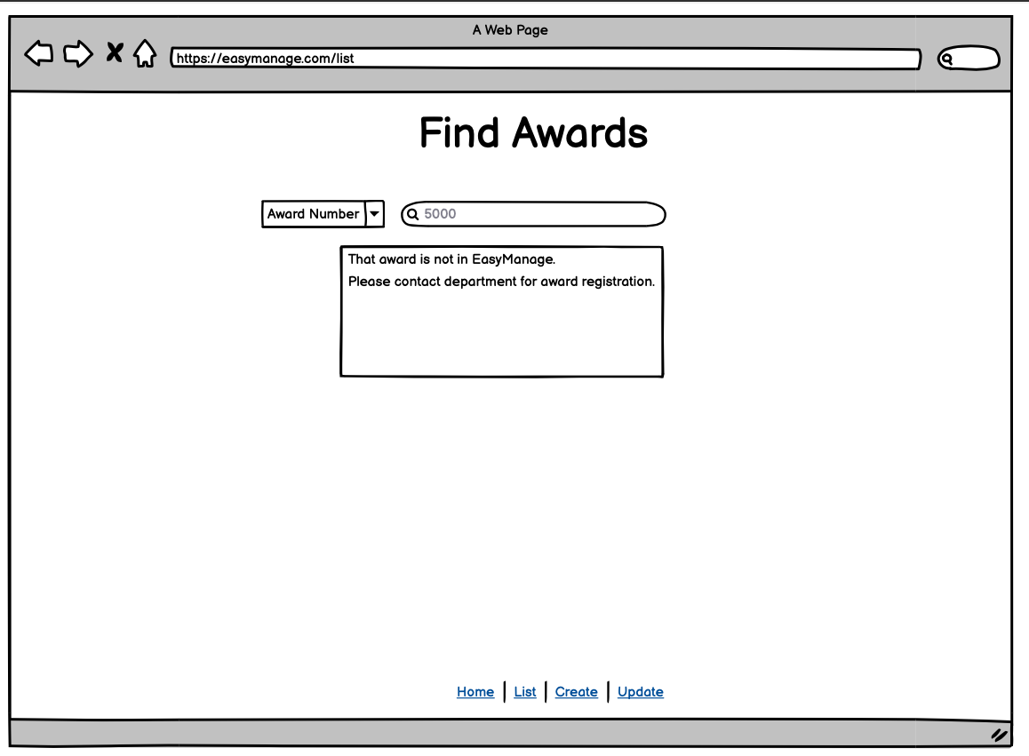
Finding Award Information in EasyManage
If an award doesn’t meet the search criteria Mary selected she will be notified that that there is no award.

Slide 13
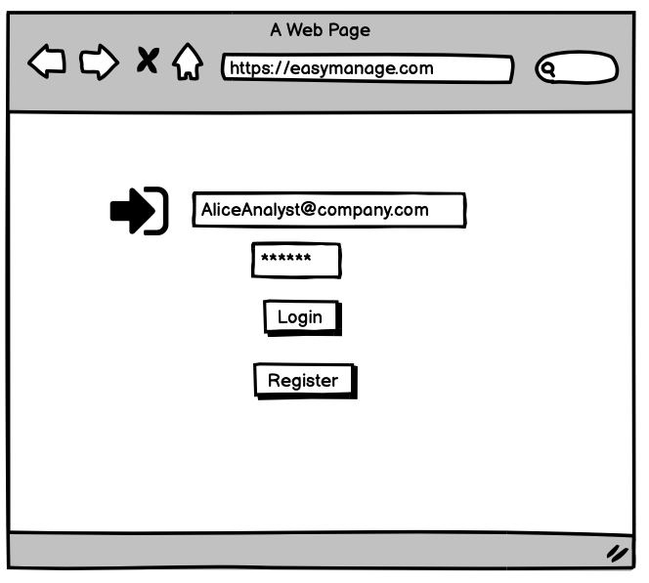
Updating Reporting Information
Alice Analyst is responsible for negotiating contract modifications with sponsors.
She will use EasyManage to modify reporting information for an award.
She will log into EasyManage using her email and password.

Slide 14
Updating Reporting Information
Once Alice has logged in she will come to the home page.
Alice can navigate to the Update page using the link

Slide 15
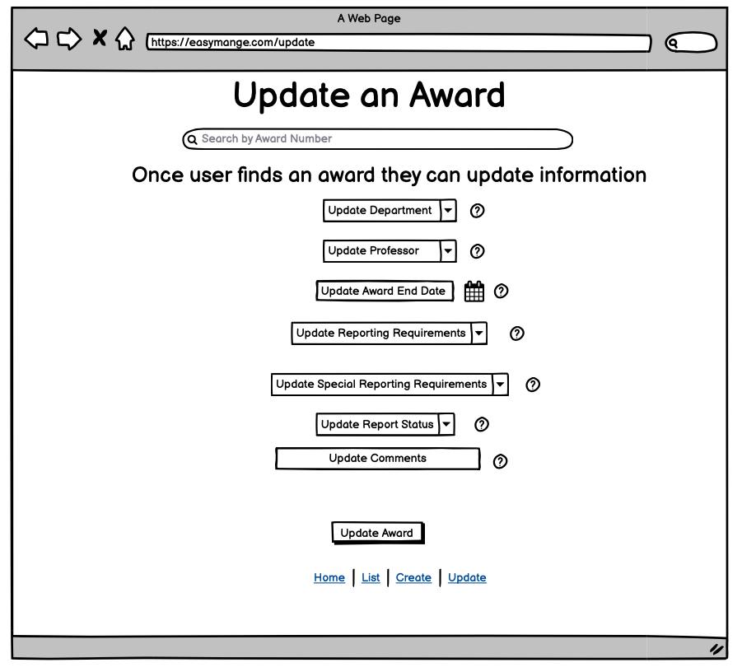
Updating Reporting Information
Alice will navigate to the Update page.
The update page will allow Alice to search for an award by its award number

Slide 16
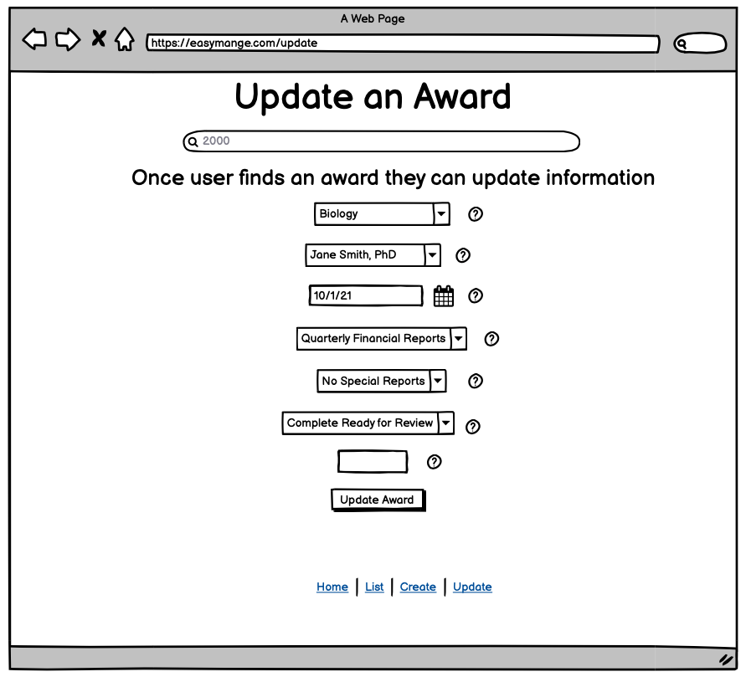
Updating Reporting Information
Once Alice Searches for an award she will be able to update reporting information.

Slide 17
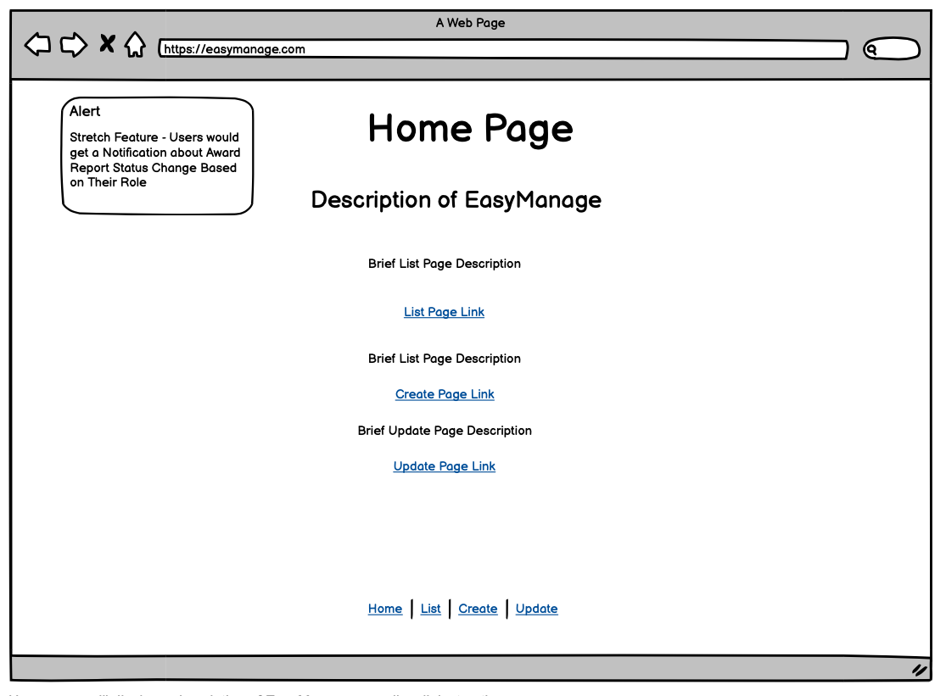
Stretch Feature
User’s will be notified when an award’s report status changes based on their role.
For example, if Alice Analyst changes a report status from WIP to Complete Ready for Review Mary Manager would get a notification when she logged into the application

